Slide 1

C Programming Basic – week 8
http://www.4shared.com/file/59509046/2c4877ca/week8.html
Gdb – Make
Tree
Lecturers :
Cao Tuan Dung
Le Duc Trung
Dept of Software Engineering
Hanoi University of Technology

Slide 2
Topics of this week
How to use debugger tool(gdb)
Tree data structure
  Binary Tree
  Binary Search Tree
Recursive processing on Tree

Slide 3
gdb for debugging (1)
gdb: the Gnu DeBugger
http://www.cs.caltech.edu/courses/cs11/material/c/mike/misc/gdb.html
Use when program core dumps
or when want to walk through execution of program line-by-line

Slide 4
gdb for debugging (2)
Before using gdb:
  Must compile C code with additional flag: -g
  This puts all the source code into the binary executable
Then can execute as: gdb myprogram
Brings up an interpreted environment

Slide 5
gdb for debugging (3)
gdb> run
Program runs...
If all is well, program exits successfully, returning you to prompt
If there is (e.g.) a core dump, gdb will tell you and abort the program

Slide 6
gdb – basic commands (1)
Stack backtrace ("where")
  Your program core dumps
  Where was the last line in the program that was executed before the core dump?
  That's what the where command tells you

Slide 7
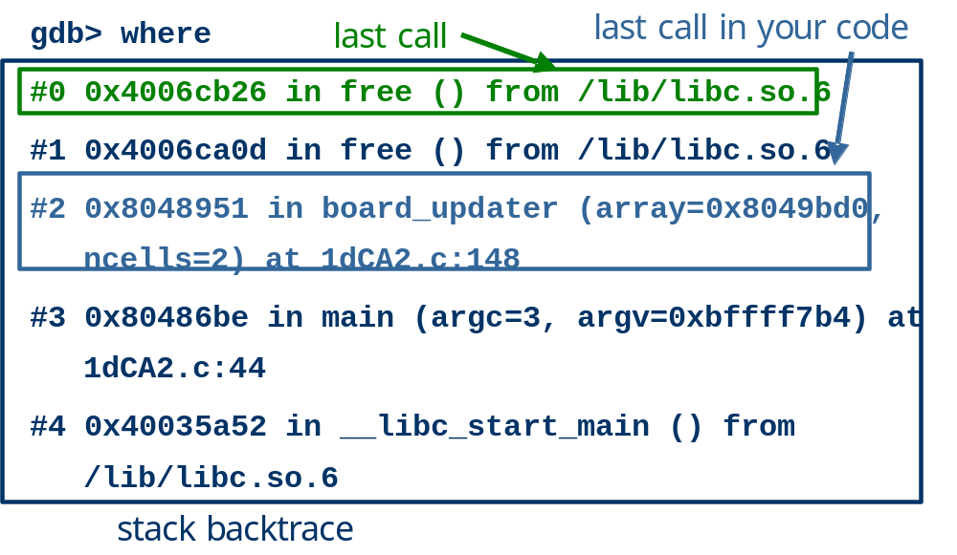
gdb – basic commands (2)
Notes:
The stack is a data structure which holds information about functions which have partially finished executing. When a function calls another function, information about the new function being called is "pushed" onto a stack. This includes information such as the arguments to the function, the contents of local variables, etc. This information is referred to as a stack frame. When the function is finished its work it "pops" the frame off the stack and returns to the previous stack frame, which belongs to the function that called it. In the above backtrace, we see that the function __libc_start_main called main which called board_updater which calledfree which called itself recursively. In this case, the functions __libc_start_main and free are C library functions which you didn't write. main is the good old main function that you write in every C program. What seems to have happened here is that something went wrong in the board_updater function, and gdb even tells you what line it happened on (which is what the "-g" option did). You should look at that line, and perhaps set a breakpoint there:
break 1dCA2.c:148 Now, when you run the program again, gdb will stop it on that line, and you will be able to print out the values of any relevant variables before free is called.

Slide 8
gdb – basic commands (3)
Look for topmost location in stack backtrace that corresponds to your code
Watch out for
  freeing memory you didn't allocate
  accessing arrays beyond their maximum elements
  dereferencing pointers that don't point to part of a malloc()ed block

Slide 9
gdb – basic commands (4)
break, continue, next, step commands
break causes execution to stop on a given line
  gdb> break foo.c: 100 (setting a breakpoint)
continue resumes execution from that point
next executes the next line, then stops
step executes the next statement
  goes into functions if necessary (next doesn't)

Slide 10
gdb – basic commands (5)
print and display commands
print prints the value of any program expression
  gdb> print i
  $1 = 100
display prints a particular value every time execution stops
  gdb> display i

Slide 11
gdb – printing arrays (1)
print will print arrays as well
int arr[] = { 1, 2, 3 };
gdb> print arr
$1 = {1, 2, 3}
N.B. the $1 is just a name for the result
print $1
$2 = {1, 2, 3}

Slide 12
gdb – printing arrays (2)
print has problems with dynamically-allocated arrays
int *arr;
arr = (int *)malloc(3 * sizeof(int));
arr[0] = 1; arr[1] = 2; arr[2] = 3;
gdb> print arr
$1 = (int *) 0x8094610
Not very useful...

Slide 13
gdb – printing arrays (3)
Can print this array by using @ (gdb special syntax)
int *arr;
arr = (int *)malloc(3 * sizeof(int));
arr[0] = 1; arr[1] = 2; arr[2] = 3;
gdb> print *arr@3
$2 = {1, 2, 3}

Slide 14
gdb – abbreviations
Common gdb commands have abbreviations
p (same as print)
c (same as continue)
n (same as next)
s (same as step)
More convenient to use when interactively debugging

Slide 15
other instruction
clear : delete break point of current file.
delete [break position]: delete breakpoint at a specific file and position
Conditional break
  gdb> break foo.c: 100 if i==-1
quit
run: restart from beginning.

Slide 16



Tree

Slide 17
Trees, Binary Trees, and Binary Search Trees
Linked lists are linear structures and it is difficult to use them to organize a hierarchical representation of objects.
Although stacks and queues reflect some hierarchy, they are limited to only one dimension.
To overcome this limitation, we create a new data type called a tree that consists of nodes and arcs. Unlike natural trees, these trees are depicted upside down with the root at the top and the leaves at the bottom.

Slide 18
Family Tree
Root
Dusty
Honey Bear
Brandy
Brunhilde
Terry
Coyote
Nugget
Gill
Tansey
Tweed
Zoe
Crocus
Primrose
Nous
Belle
leaf

Slide 19
Definition of tree
A tree is a finite set of one or more nodes
such that:
There is a specially designated node called
the root.
The remaining nodes are partitioned into n>=0 disjoint sets T1, ..., Tn, where each of these sets is a tree.
We call T1, ..., Tn the subtrees of the root.

Slide 20
Recursive definition
Root of Tree T
T1
T2
T3
T4
T5
SubTree

Slide 21
Binary Tree
A binary tree is a tree in which no node can have more than two children.
Each node has 0, 1, or 2 children

Slide 22
Linked Representation
Each tree node is represented as an object whose data type is
The space required by an n node binary tree is n * (space required by one node)
  typedef ... elmType;
  //whatever type of element
  typedef struct nodeType {
    elmType element;
    struct nodeType *left, *right;
  };
  typedef struct nodeType *treetype;
element (data)
left child right child

Slide 23
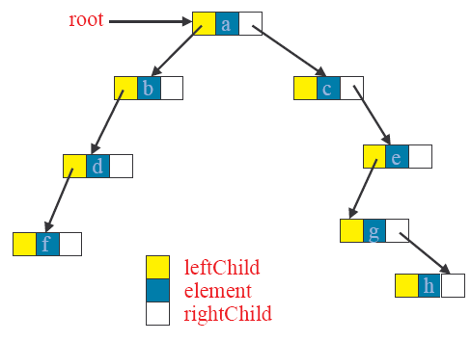
A linked binary tree

Slide 24
Binary Tree ADT
makenullTree(treetype *t)
creatnewNode()
isEmpty()

Slide 25
Tree initialization and verification
  typedef … elmType;
  typedef struct nodeType {
    elmType element;
    struct nodeType *left, *right;
  } node_Type;
  typedef struct nodeType *treetype;
  void MakeNullTree(treetype *T){
  (*T)=NULL;
  }
  int EmptyTree(treetype T){
  return T==NULL;
  }

Slide 26
Access left and right child
treetype LeftChild(treetype n)
{
if (n!=NULL) return n->left;
else return NULL;
}
treetype RightChild(treetype n)
{
if (n!=NULL) return n->right;
else return NULL;
}

Slide 27
create a new node
node_type *create_node(elmtype NewData)
{
node_type *N;
N=(node_type*)malloc(sizeof(node_type));
if (N != NULL)
{
N->left = NULL;
N->right = NULL;
N->element = NewData;
}
return N;
}

Slide 28
check if a node is a leaf
int IsLeaf(treetype n){
if(n!=NULL)
  return(LeftChild(n)==NULL)&&(RightChild(n)==NULL);
  else return -1;
}

Slide 29
Recursive processing:
Number of nodes
As tree is a recursive data structure, recursive algorithms are usefuls when they are applied on tree.
int nb_nodes(treetype T){
if(EmptyTree(T)) return 0;
  else return 1+nb_nodes(LeftChild(T))+
    nb_nodes(RightChild(T));
}

Slide 30
Creat a tree from two sub-trees
treetype createfrom2(elmtype v, treetype l, treetype r){
treetype N; N=(node_type*)malloc(sizeof(node_type));
N->element=v;
N->left=l;
N->right=r;
return N;
}

Slide 31
Adding a new node to the left most position
treetype Add_Left(treetype *Tree, elmtype NewData){ node_type *NewNode = Create_Node(NewData);
if (NewNode == NULL) return (NewNode);
if (*Tree == NULL)
*Tree = NewNode;
else{
node_type *Lnode = *Tree;
while (Lnode->left != NULL)
Lnode = Lnode->left;
Lnode->left = NewNode;
}
return (NewNode);
}

Slide 32
Adding a new node to the right most position
treetype Add_Right(treetype *Tree, elmtype NewData){ node_type *NewNode = Create_Node(NewData);
if (NewNode == NULL) return (NewNode);
if (*Tree == NULL)
*Tree = NewNode;
else{
node_type *Rnode = *Tree;
while (Rnode->right != NULL)
Rnode = Rnode->right;
Rnode->right = NewNode;
}
return (NewNode);
}

Slide 33
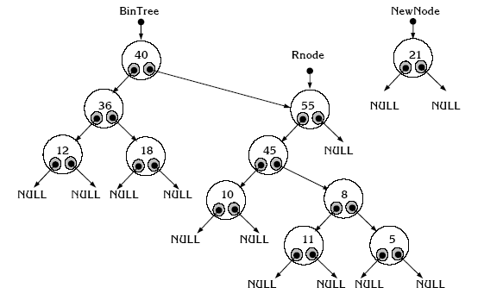
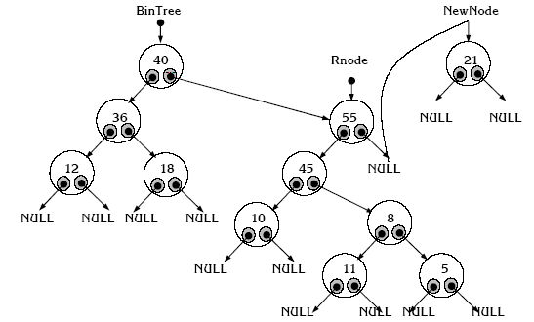
Illustration

Slide 34
Exercise (BTVN)
Develop the following helper functions for a tree:
  return the height of a binary tree.
  return the number of leafs
  return the number of internal nodes
  count the number of right children.

Slide 35
Exercise
A binary can represent an arithmetic expression: The leaves are operands and the other nodes are operators.
The left and right subtrees of an operator node represent subexpressions that must be evaluated before applying the operator at the root of the subtree.
For example
  !a + (b – c)/d
Write a program create a tree
representing this expression
+
+
/
!
/
!
-
-
d
a
d
a
b
b
c
c

Slide 36
Exercise at Home
Write an menu program that take a valid arithmetic expression as input and:
  Store and represent it in a tree
  Evaluate the expression.
+
*
/
5
2
-
3
12
3

Slide 37
BTVN 4EF
Tạo file văn bản USopen.txt có nội dung sau:
  Dòng 1 chứa 16 đối thủ
Xây dựng cây mô tả kết quả thi đấu cho tới trận chung kết. Ban đầu 16 đối thủ là các nút lá.
Lựa chọn người chơi thắng trong một trận đấu là ngẫu nhiên.
In kết quả ra file treegame.txt

Slide 38
Binary Search Tree
v
  Every element has a unique key.
  The keys in a nonempty left subtree (right subtree) are smaller (larger) than the key in the root of subtree.
  The left and right subtrees are also binary search trees.
≤ v
≥ v
BST
BST
7
7
3
9
3
9
2
5
2
5
8

Slide 39
Binary Search Tree Implementation
#include <stdio.h>
#include <stdlib.h>
typedef . . . KeyType; // specify a type for the data
typedef struct Node{
KeyType key;
  struct Node* left,right;
  } NodeType;
typedef Node* TreeType;

Slide 40
Search on BST
TreeType Search(KeyType x,TreeType Root){
if (Root == NULL) return NULL; // not found
else if (Root->key == x) /* found x */
return Root;
else if (Root->key < x)
//continue searching in the right sub tree
return Search(x,Root->right);
else {
// continue searching in the left sub tree
return Search(x,Root->left);
}
}

Slide 41
Insert a node from a BST
In a binary, there are not two nodes with the same key.
void InsertNode(KeyType x,TreeType *Root ){
if (*Root == NULL){
/* Create a new node for key x */
  *Root=(NodeType*)malloc(sizeof(NodeType));
  (*Root)->key = x;
  (*Root)->left = NULL;
  (*Root)->right = NULL;
}
else if (x < (*Root)->key) InsertNode(x, &(*Root)->left);
else if (x> Root->key) InsertNode(x, &(*Root)->right);
}

Slide 42
Insert a node from a BST
Version with the return type
TreeType InsertNode(KeyType x,TreeType Root ){
if (Root == NULL){
/* Create a new node for key x */
  Root=(NodeType*)malloc(sizeof(NodeType));
  Root->key = x;
  Root->left = NULL;
  Root->right = NULL;
  Return Root;
}
else if (x < Root->key) return InsertNode(x, Root->left);
else if (x> Root->key) return InsertNode(x, Root->right);
}

Slide 43
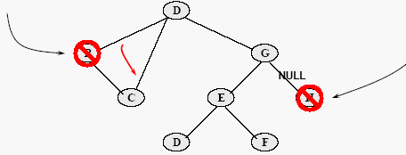
Delete a node from a BST
Removing a leaf node is trivial, just set the relevant child pointer in the parent node to NULL.
Removing an internal node which has only one subtree is also trivial, just set the relevant child pointer in the parent node to target the root of the subtree.

Slide 44
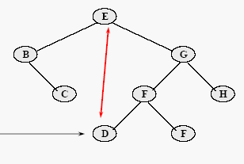
Delete a node from a BST
Removing an internal node which has two subtrees is more complex
  Find the left-most node of the right subtree, and then swap data values between it and the targeted node.
  Delete the swapped value from the right subtree.

Slide 45
Find the left-most node of right sub tree
This function find the leftmost node then delete it.
KeyType DeleteMin (TreeType *Root ){
KeyType k;
if ((*Root)->left == NULL){
  k=(*Root)->key;
  (*Root) = (*Root)->right;
  return k;
}
else return DeleteMin(&(*Root)->left);
}

Slide 46
Delete a node from a BST
void DeleteNode(key X,TreeType *Root){
if (*Root!=NULL)
if (x < (*Root)->Key) DeleteNode(x, &(*Root)->left)
else if (x > (*Root)->Key)
DeleteNode(x, &(*Root)->right)
else if
((*Root)->left==NULL)&&((*Root)->right==NULL)
  *Root=NULL;
else if ((*Root)->left == NULL)
*Root = (*Root)->right
  else if ((*Root)->right==NULL)
  *Root = (*Root)->left
    else (*Root)->Key = DeleteMin(&(*Root)->right);
}

Slide 47
Pretty print a BST
void prettyprint(TreeType tree,char *prefix){
char *prefixend=prefix+strlen(prefix);
if (tree!=NULL){
printf("%04d",tree->key);
if (tree->left!=NULL) if (tree->right==NULL){
printf("\304");strcat(prefix," ");
}
else {
printf("\302");strcat(prefix,"\263 ");
}
prettyprint(tree->left,prefix);
*prefixend='\0';
if (tree->right!=NULL) if (tree->left!=NULL){
printf("\n%s",prefix);printf("\300");
} else printf("\304");
strcat(prefix," ");
prettyprint(tree->right,prefix);
}
}

Slide 48
Exercise
Write a function to delete all node of a tree. This function must be called before terminating program.

Slide 49
Solution
void freetree(TreeType tree)
{
if (tree!=NULL)
{
freetree(tree->left);
freetree(tree->right);
free((void *) tree);
}
}

Slide 50
Exercise
Create a binary search tree with 10 nodes. Each node contains a random integer.
Ask user to input a number and search for it.
Print the content of the trees.

Slide 51
Min Max trong BST
Viết hai hàm FindMin – FindMax cho thư viện cây nhị phân tìm kiếm.
Tham số: con trỏ root
Return: con trỏ tới nút nhỏ nhất hay lớn nhất.

Slide 52
Solution
#include <stdio.h>
#include <stdlib.h>
#include <bsttree.h> // create by your self
#include <time.h>
int main(){
TreeType p, tree = NULL;
int i, n = 0;
srand(time(NULL));
for ( i = 0; i < 10; i++ )
insert (rand() % 100, tree );
printf("pretty print:\n");
strcpy(prefix," ");
prettyprint(tree,prefix);
printf("\n");
do {
printf("Enter key to search (-1 to quit):");
scanf("%d", &n);
p= Search(n, tree);
if (p!=NULL) printf("Key %d found on the tree",n);
else insert(n, tree);
while (n!=-1);
return 0;
}

Slide 53
Exercise – BTVN1
We assume that you make a mobile phone’s address book.
Declare a structure which can store at least "name", "telephone number", "e-mail address.”.
Declare a structure for a binary tree which can stores the structure of an address book inside. Read data of about 10 from an input file to this binary tree as the following rules.
  An address data which is smaller in the dictionary order for the e-mail address is stored to the left side of a node.
  An address data which is larger in the dictionary order for the e-mail address is stored to the right side of a node.
(1) Confirm the address data is organized in the binary tree structure with some methods (printing, debugger, etc).
(2) Find a specified e-mail address in the binary tree and output it to a file if found.
(3) Output all the data stored in the binary tree in ascending order for the e-mail address. (Reserve it for the next week)

Slide 54
Solution
#include <stdio.h>
#define MAX 20
typedef struct phoneaddress_t {
char name[20];
char tel[11];
char email[25];
}phoneaddress;
typedef struct Node{
phoneaddress key;
struct Node* Left,Right;
} NodeType;
typedef Node* TreeType;

Slide 55
Search function
TreeType Search(char* email,TreeType Root){
if (Root == NULL) return NULL; // not found
else if (strcmp((Root->Key).email, email) == 0) return Root;
else if (strcmp((Root->Key).email, email) < 0)
//continue searching in the right sub tree
return Search(email,Root->right);
else {
// continue searching in the left sub tree
return Search(email,Root->left);
}
}

Slide 56
Insert a node
void InsertNode(phoneaddress x,TreeType *Root ){
if (*Root == NULL){
*Root=(NodeType*)malloc(sizeof(NodeType));
(*Root)->Key = x;
(*Root)->left = NULL;
(*Root)->right = NULL;
}
else if (strcmp(((*Root)->Key).email, x.email) > 0)
InsertNode(x, (*Root)->left);
else if (strcmp(((*Root)->Key).email, x.email) > 0) InsertNode(x,(*Root)->right);
}

Slide 57
Solution
int main(void)
{
FILE *fp;
phoneaddress phonearr[MAX];
treetype root;
int i,n, irc; // return code
int reval = SUCCESS;
int n=10;
//read from this file to array again
if ((fp = fopen("phonebook.dat","rb")) == NULL){
printf("Can not open %s.\n", "phonebook.dat");
reval = FAIL;
}
irc = fread(phonearr, sizeof(phoneaddress), n, fp);
fclose(fp);

Slide 58
Solution
. . .;
for (i=0; i<n; i++)
root = InsertNode(phonearr[i],root);
pretty_print(root,0);
// Search for an email
// Do it by your self
. . .
}

Slide 59
Bài tập về nhà 2
Viết chương trình từ điển thuật ngữ tin học Anh Việt. Tiếng Việt không dấu.
Gợi ý: Một mục từ gồm: từ tiếng Anh – giải nghĩa tiếng Việt.
Dùng cấu trúc BST để lưu trữ.
Chương trình phải cho phép: tìm kiếm, thêm từ, xóa từ và ghi dữ liệu vào file.
Mở rộng: Mỗi từ có 1 danh sách các từ đồng nghĩa.

Slide 60
Bài tập về nhà 3
Kiểm tra tốc độ tìm kiếm của một cây nhị phân như sau.
Sinh ra 1 triệu số nguyên ngẫu nhiên (chú ý đảm bảo tính ngẫu nhiên) và cho vào cây. Chú ý nếu một số đã nằm trong cây thì không cần bổ sung.
Sau đó in ra chiều cao của cây.
Chương trình cho phép:
  Tạo lại bộ số liệu (Chú ý giải phóng bộ nhớ dành cho cây cũ).
  Thực hiện tìm kiếm và in ra số phép so sánh.

Slide 61
Ghi chú
Nộp bài tập – cần nộp kèm thư viện đã làm trên lớp / phát triển từ các buổi thực hành trước.
Tách riêng thư viện cấu trúc dữ liệu và chương trình chính.s

Slide 62
BTVN ICT54C
Tiếp tục phát triển Chương trình CSDL Điện thoại NokiaDB.
Viết lại chương trình sử dụng cây nhị phân tìm kiếm. Khóa của 1 nút là Model của điện thoại.
Chương trình có các chức năng: Import, Thêm, Xóa, Cập Nhật, Tìm Kiếm, Hiển thị danh sách.

Slide 63
Xử lý biểu thức toán học với cây nhị phân
Viết chương trình xây dựng cây nhị phân từ biểu thức số học diễn đạt ở dạng hậu tố.
Kiểm tra kết quả bằng tính năng duyệt theo thứ tự giữa.
Tính giá trị biểu thức
Notes:
BT VN59

Slide 64
Thuật toán tính giá trị BT từ cây nhị phân số học
int Eval ( TreeNode* ptr )
{
switch ( ptr->info.whichType )
{
  case OPERAND : return ptr->info.operand ;
  case OPERATOR :
  switch ( tree->info.operation )
    {
    case ‘+’ : return ( Eval ( ptr->left ) + Eval ( ptr->right ) ) ;
    case ‘-’ : return ( Eval ( ptr->left ) - Eval ( ptr->right ) ) ;
    case ‘*’ : return ( Eval ( ptr->left ) * Eval ( ptr->right ) ) ;
    case ‘/’ : return ( Eval ( ptr->left ) / Eval ( ptr->right ) ) ;
    }
}
}

Slide 65
Constructing an Expression Tree
There is a simple O(N) stack-based algorithm to convert a postfix expression into an expression tree.
Recall we also have an algorithm to convert an infix expression into postfix, so we can also convert an infix expression into an expression tree without difficulty (in O(N) time).

Slide 66
Expression Tree Algorithm
Read the postfix expression one symbol at time:
  – If the symbol is an operand, create a one-node tree and push a pointer to it onto the stack.
  – If the symbol is an operator, pop two tree pointers T1 and T2 from the stack, and form a new tree whose root is the operator, and whose children are T1 and T2.
  – Push the new tree pointer on the stack.

Slide 67
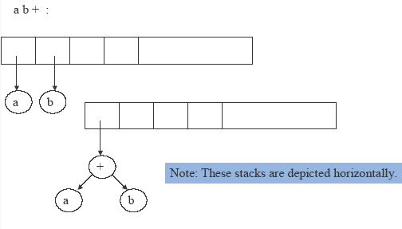
Example

Slide 68
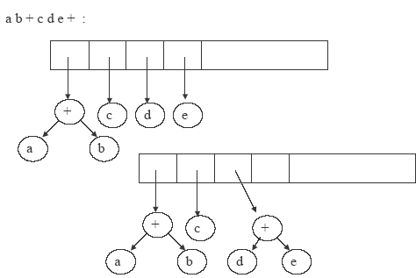
Example

Slide 69
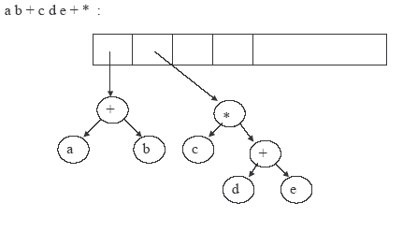
Example

Slide 70
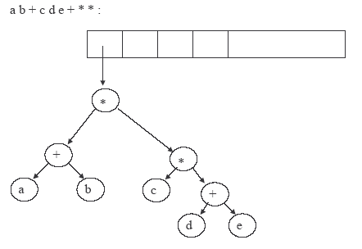
Example

Slide 71
Ứng dụng chăm sóc khách hàng
Siêu thị Topcare quản lý các thông tin mua sắm của khách hàng để phục vụ chiến lược kinh doanh. Mỗi khách hàng được phát một thẻ với mã số. Khi khách thanh toán tiền ở siêu thị, số tiền thanh toán, nhóm hàng hóa giá trị nhất sẽ được lưu trữ tích lũy vào cơ sở dữ liệu. Có ba nhóm hàng hóa: Thực phẩm, Hàng điện tử, và May mặc.
Sử dụng cấu trúc BST với mỗi nút chứa trường thông tin là mã số khách hàng, tên, Tổng tiền mua sắm, thống kê nhóm hàng hóa
VD
CLI01234AA9 Trần Bình 12.000.230 TP = 1 DT = 6 MM=3
Viết chương trình đọc dữ liệu từ file mỗi dòng là một giao dịch của khách hàng tại siêu thị có cấu trúc sau
  MSKH Tên Giá trị hàng TP Giá trị DT Giatri MM
Duyệt cây và in ra thông tin.

Slide 72
Test.txt
CLI0123SDH Nguyễn Trấn Đạt – 230000 450000 51000
CLI0032IPA Hoàng Thu Nga – 0 200000 31000
CLI0124SDH Lê Phú – 0 0 121000
CLI0032IPA Hoàng Thu Nga – 23000 110000 0
CLI0003IPA Trần Hiếu – 630000 150000 1051000
CLI0124SDH Lê Phú – 0 0 700000
CLI0123SDH Nguyễn Trấn Đạt – 50000 150000 33000

Slide 73
Stack Exercise: Function call simulation.
In C program, when a function is invoked, a activation frame with the following structure is created and push to system stack.
Activation Frame
  Function name
  Return address to the caller
  parameters of the callee
  Locals to the callee.
When a function finish, the corresponding AF is pop off the system stack and its value is returned back to the address of caller.
Write a program with the menu that help you debug the functions call in a source code with the following functionality
1. Invoked Function
2. End Function.
3. Print Top of Stack
Notice that you can not terminate a function that is not on top of stack. It means that this function call to another function.

